Slide 1
Hospital management system
Team no: 6
Team members:
B jahnavi sri kavya
S vishnupriya
B priyanka

Slide 2
objectives
The project “Hospital management system” is aimed to develop to maintain the day –to-day state of admission/discharge of patients, list of doctors, reports generation etc. It is designed to achieve the following objectives:
To computerize all details regarding patient details & hospital details.
Scheduling the appointment of patient with doctors to make it convenient for both.
The inventory should be updated automatically whenever a transaction is made.
The information of the patients should be kept up to date and there record should be kept in the system for historical purposes.

Slide 3
Software requirements & Work done
Software Requirements:
Java jdk1.8.0_221
DATABASE : sql
Work Done:
Algorithm
Miniature Model
Use Case Diagram
Modules

Slide 4
Algorithm
FOR DOCTORS:
Step 1:
Start.
Step 2:
Open Hospital Management web page, to create new membership for Doctor proceed with step 3 or if there is existing user proceed with step 6.
Step 3:
Click on new membership link to create new membership for doctor. Allocate memory for storing the information of new doctor.
Step 4:
Enter the information of the new doctor.

Slide 5
Step 5:
Proceed if all information are entered properly and display new account details, else show appropriate error for incorrect information.
Step 6:
You can search the patients who are treated under respective doctor by clicking on the link.
Step 7:
You can check the patient health report, account details of patient and also doctor (Salary), date of treatment.
FOR PATIENTS:
Step 1:
Open Hospital Management web page, to create new membership for patient proceed with step 2 or if there is existing user proceed with step 5.
Step 2:
Click on new membership link to create new membership for patient. Allocate memory for storing the information of new patient.

Slide 6
Step 3:
Enter the information of the new patient.
Step 4:
Proceed if all information are entered properly and display new account details, else show appropriate error for incorrect information.
Step 5:
You can find your respective doctors by clicking respective link.
Step 6:
You can also find your health progress, treatment timings, medicine details, room allotment details, fee payment and discharge details.
Step 7:
Stop.

Slide 7
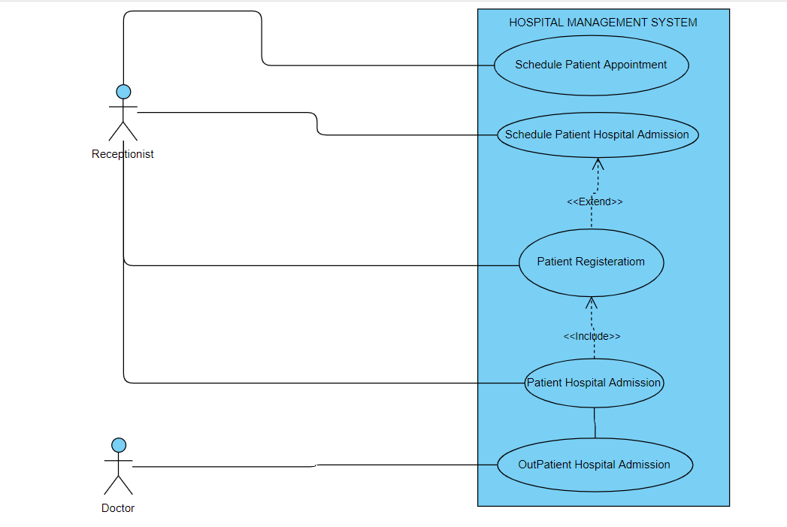
Use Case Diagram

Slide 8
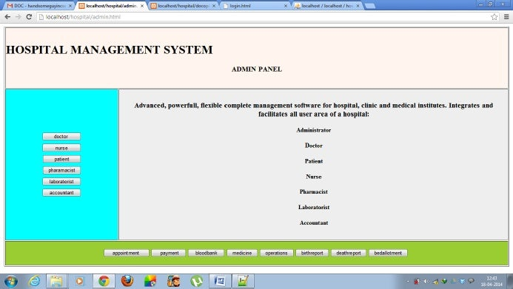
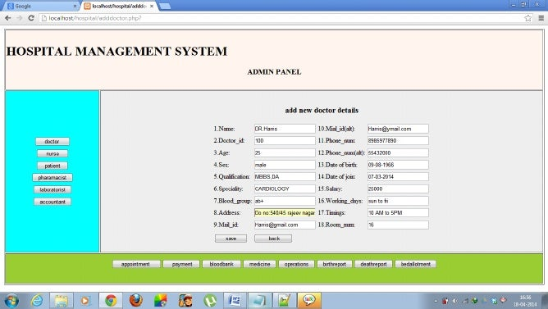
Miniature model

Slide 9
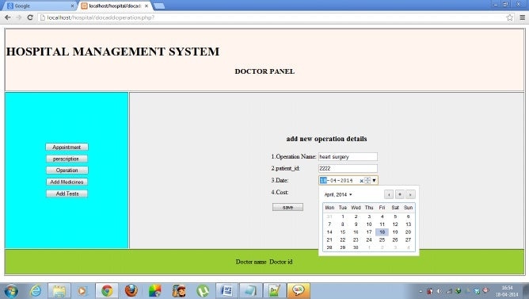
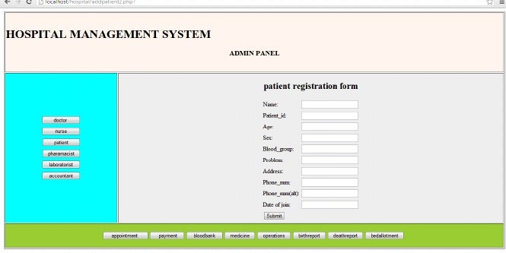

Slide 10
WORKS TO BE DONE
Insertion, Search and connection to database.
Link between doctor and patient.
MS Access Database Connection.
Changes to be done according to the update of the system.

Slide 11
Specific references
Herbert Schildt, “The Java 2: Complete Reference”, Fifth edition, TMH.
MySQL Database Applications, 2nd Edition by Brad Bulger

